Slide 1








Community News
x.com/alperebicoglu
github.com/ebicoglu
Alper EBICOGLU
linkedin.com/in/ebicoglu
Co-Founder of Volosoft
medium.com/@alperonline

Slide 2

Latest ABP Releases
ABP 9.2.3 stable
ABP 9.3.0-rc.3 Planned stable version release 1st August 2025

Slide 3
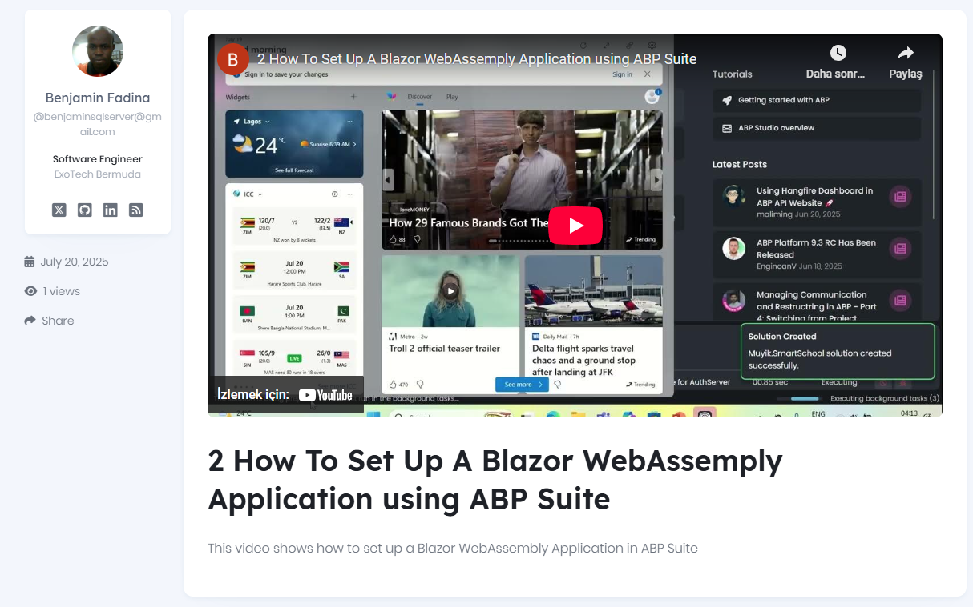
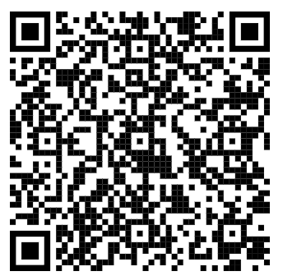
Community News
Notes:
This video shows how to set up a Blazor WebAssembly Application in ABP Suite

Slide 4
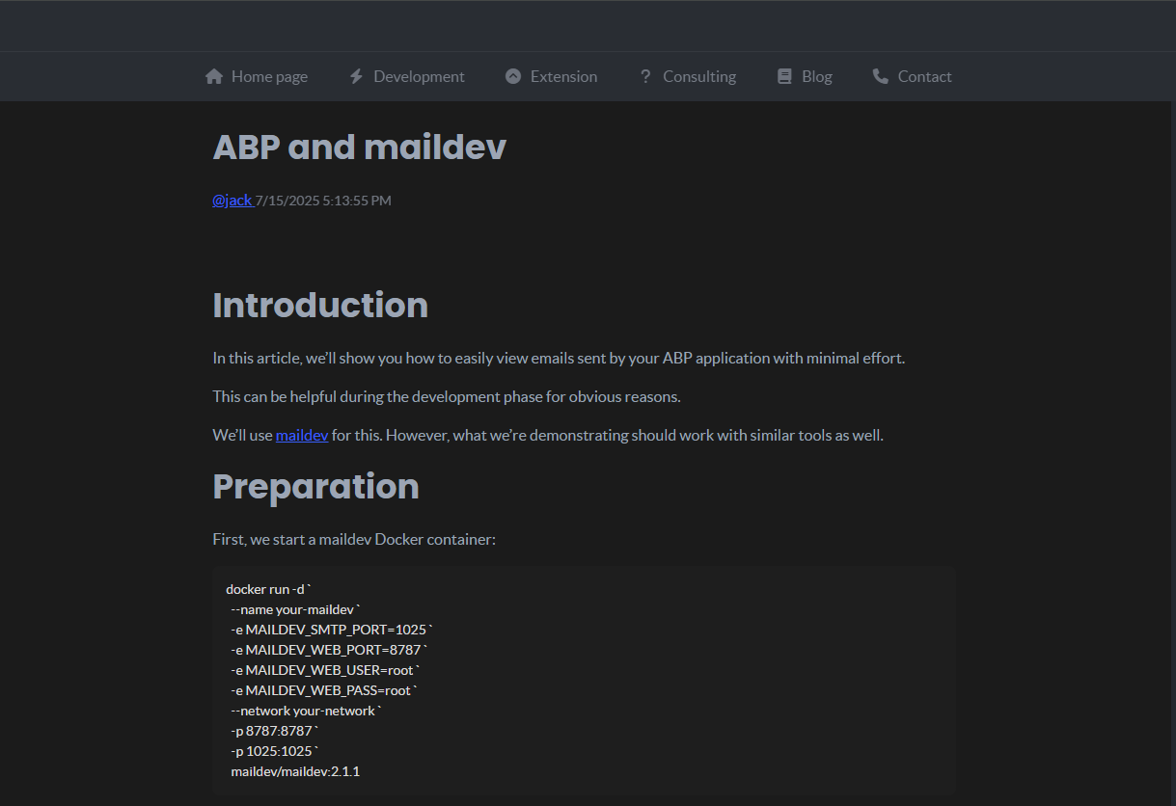
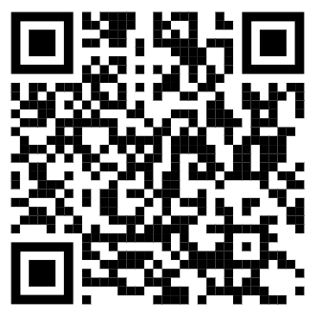
Community News
Notes:
The blog explains how to use MailDev with ABP Framework to easily view outgoing emails during development. It covers running MailDev via Docker, creating a passwordless email sender for dev environments, swapping the default email sender in debug mode, and updating SMTP config. Result: You can see all dev emails in MailDev’s web UI at localhost:8787.

Slide 5
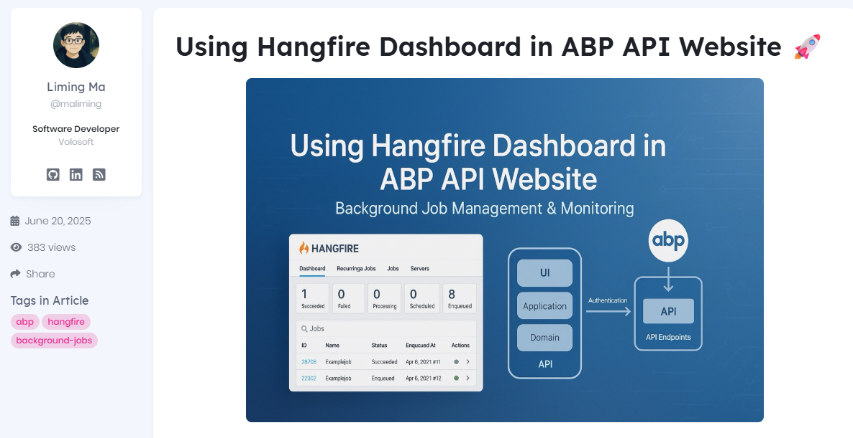
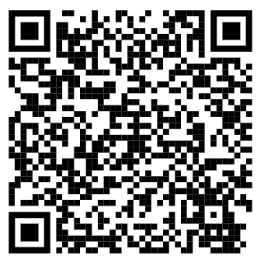
Community News
Notes:
Shows how to securely add Hangfire Dashboard (a background job management UI) to an ABP API project using JWT authentication. It covers the steps for configuring authentication and integrating the dashboard, so only logged-in users can access it, making job monitoring and management both easy and secure.

Slide 6
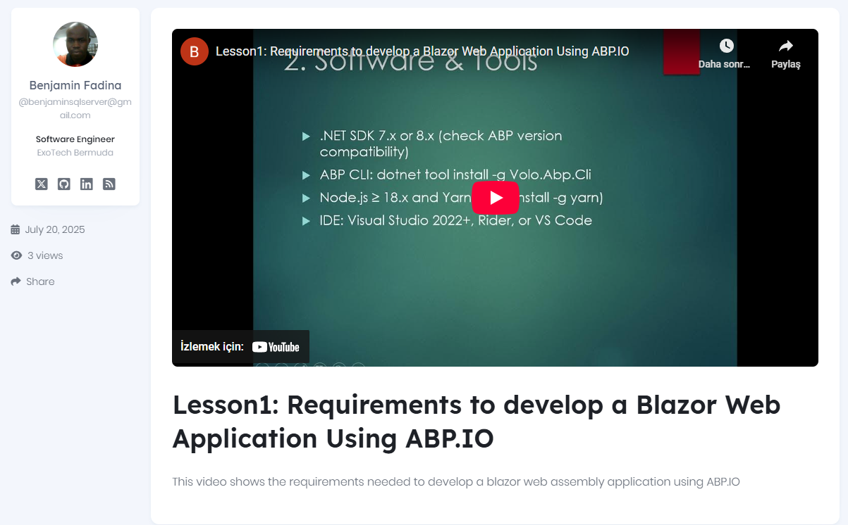
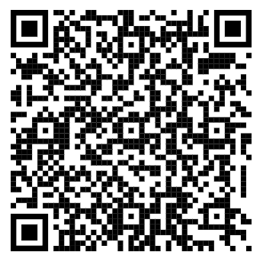
Community News
Notes:
This lesson introduces the requirements for developing a Blazor WebAssembly app using ABP. It covers the necessary system specifications, software tools, and development environment.

Slide 7
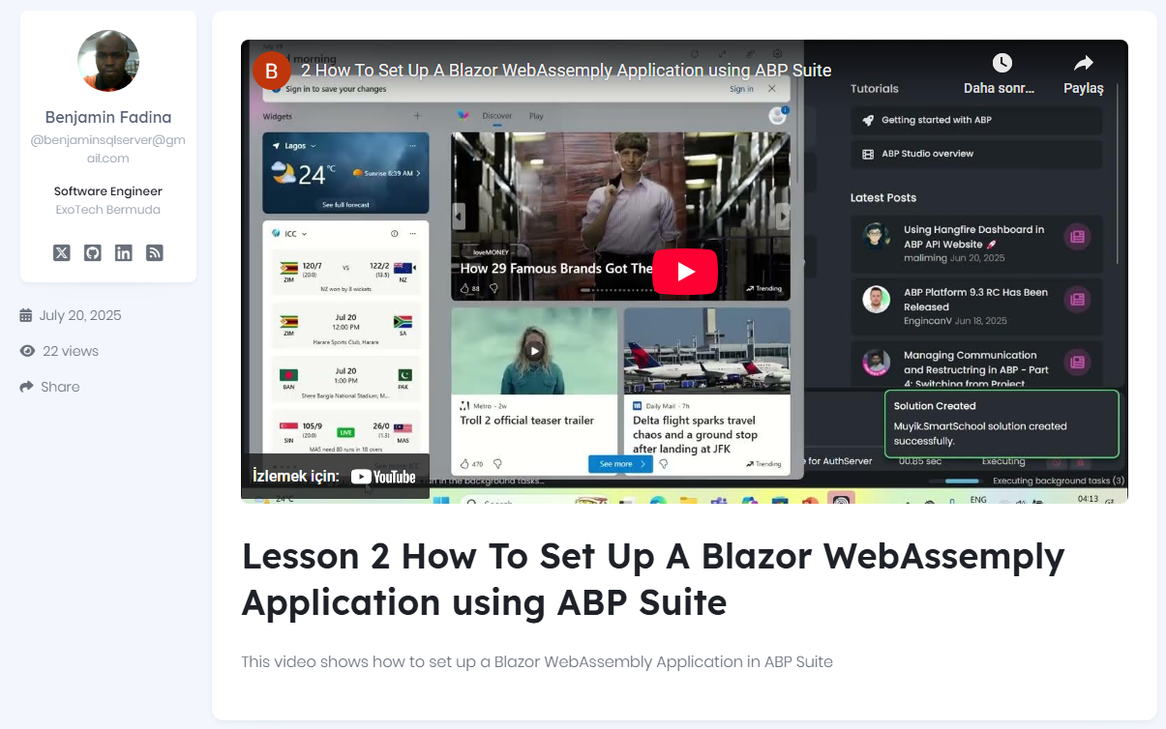
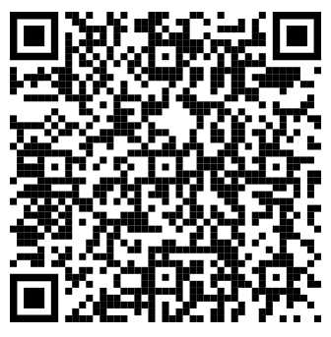
Community News
Notes:
Lesson 2- creating a new Blazor WebAssembly via ABP Suite

Slide 8
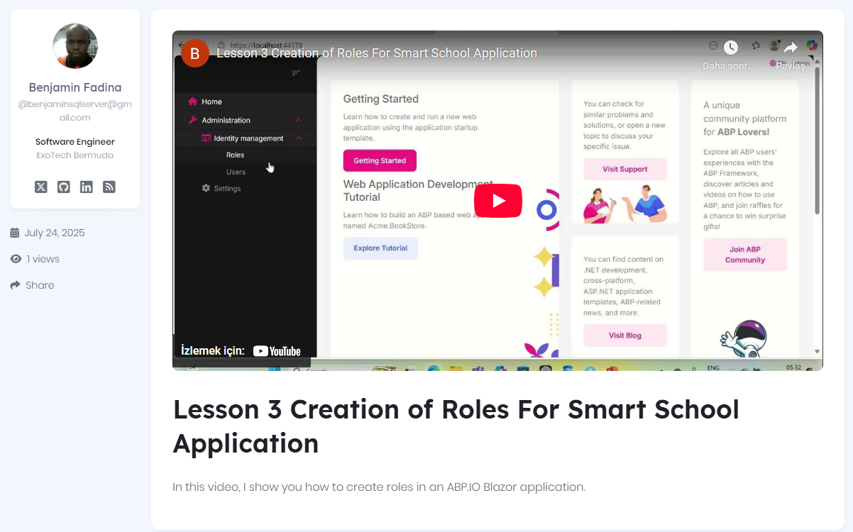
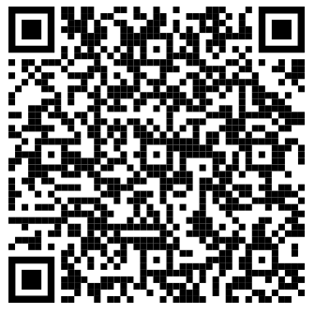
Community News
Notes:
Lesson 3- Explaining Roles

Slide 9
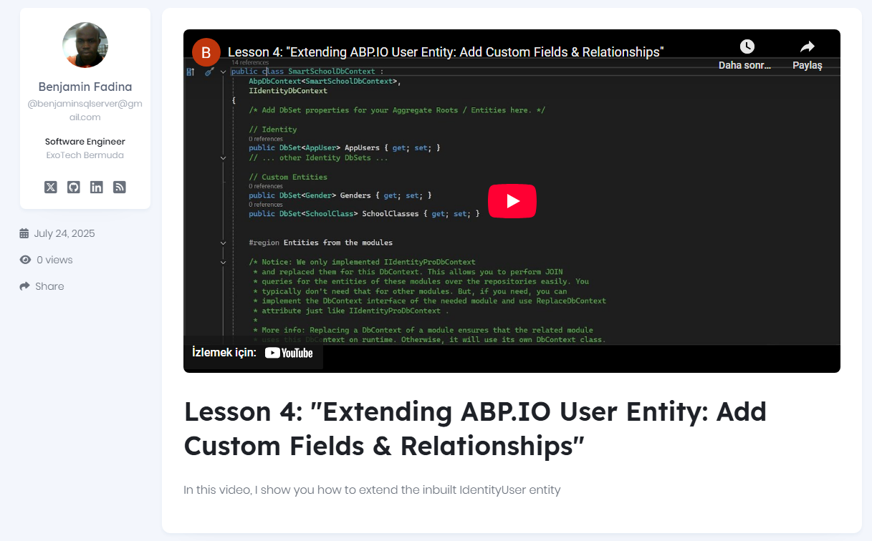
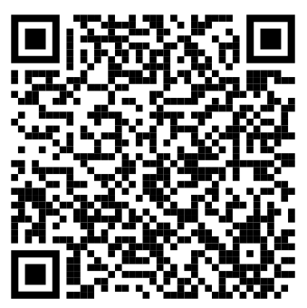
Community News
Notes:
Lesson 4- extending the Identity User entity

Slide 10
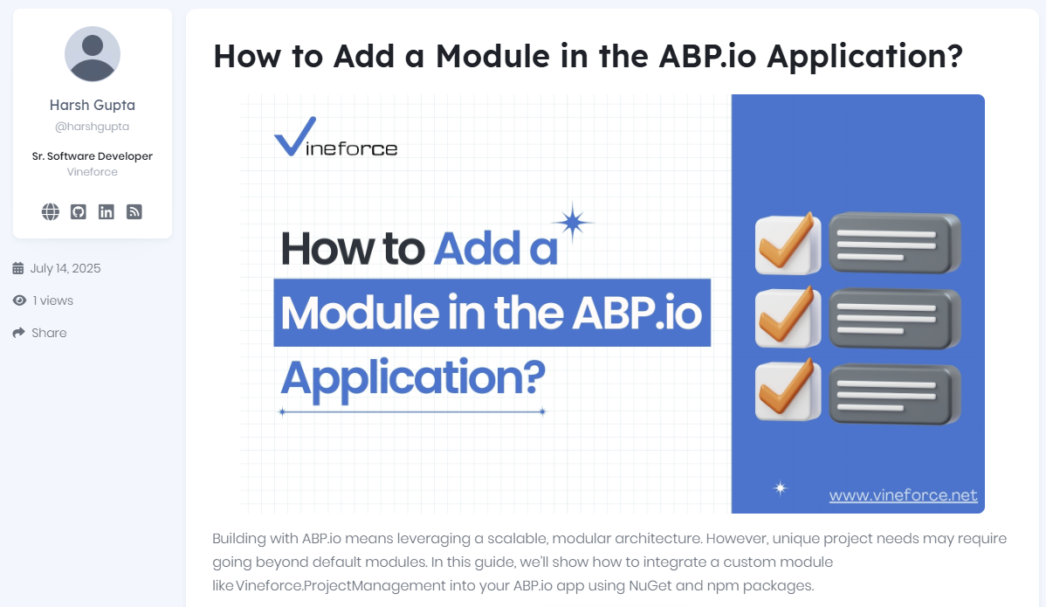
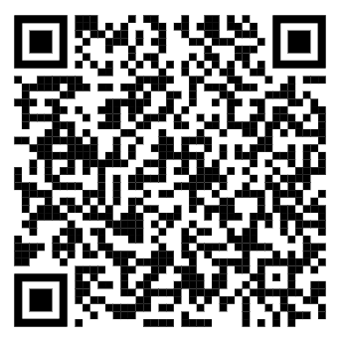
Community News
Notes:
This guide walks you through creating and integrating a custom module into your ABP application.
Showing how to setup required apps. Creating main application and sub module. And how to reference it into your main app.
A basic step by step tutorial for module usage.

Slide 11
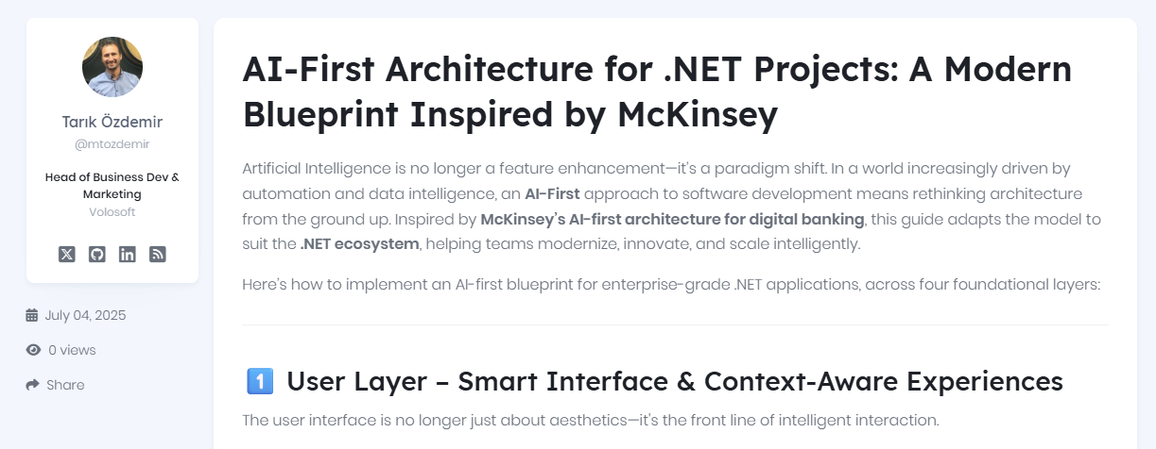
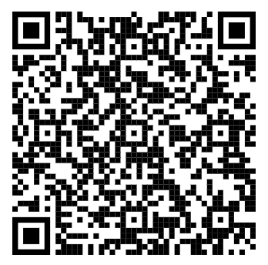
Community News
Notes:
The article outlines an AI-first blueprint for .NET apps: use smart UIs, embed ML/LLM intelligence, build scalable AI-ready infrastructure, and create new roles for AI-driven teams. The core message: design with AI at the center for future-proof, intelligent enterprise applications.

Slide 12
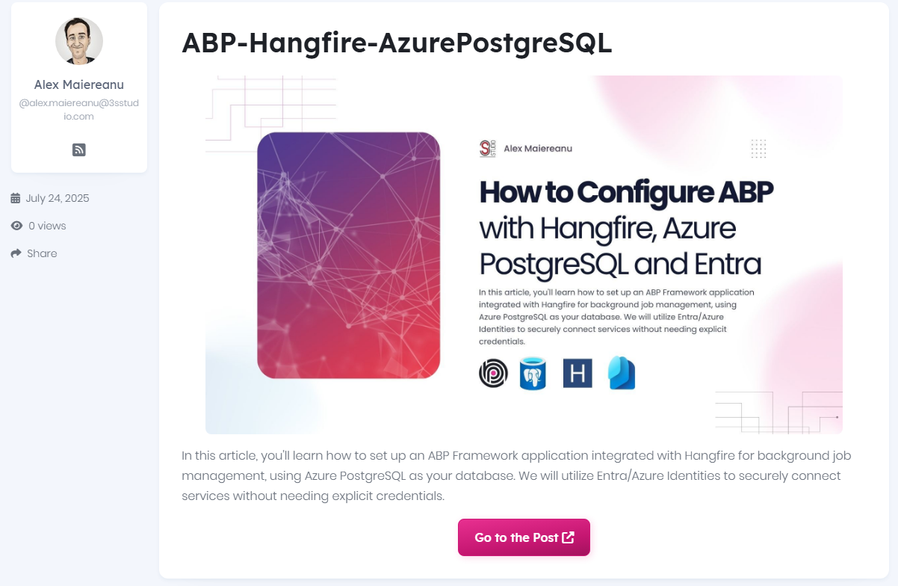
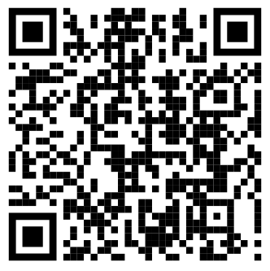
Community News
Notes:
The article outlines an AI-first blueprint for .NET apps: use smart UIs, embed ML/LLM intelligence, build scalable AI-ready infrastructure, and create new roles for AI-driven teams. The core message: design with AI at the center for future-proof, intelligent enterprise applications.

Slide 13
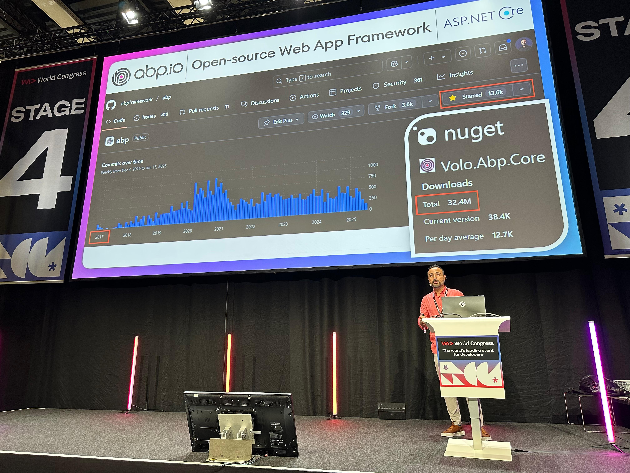
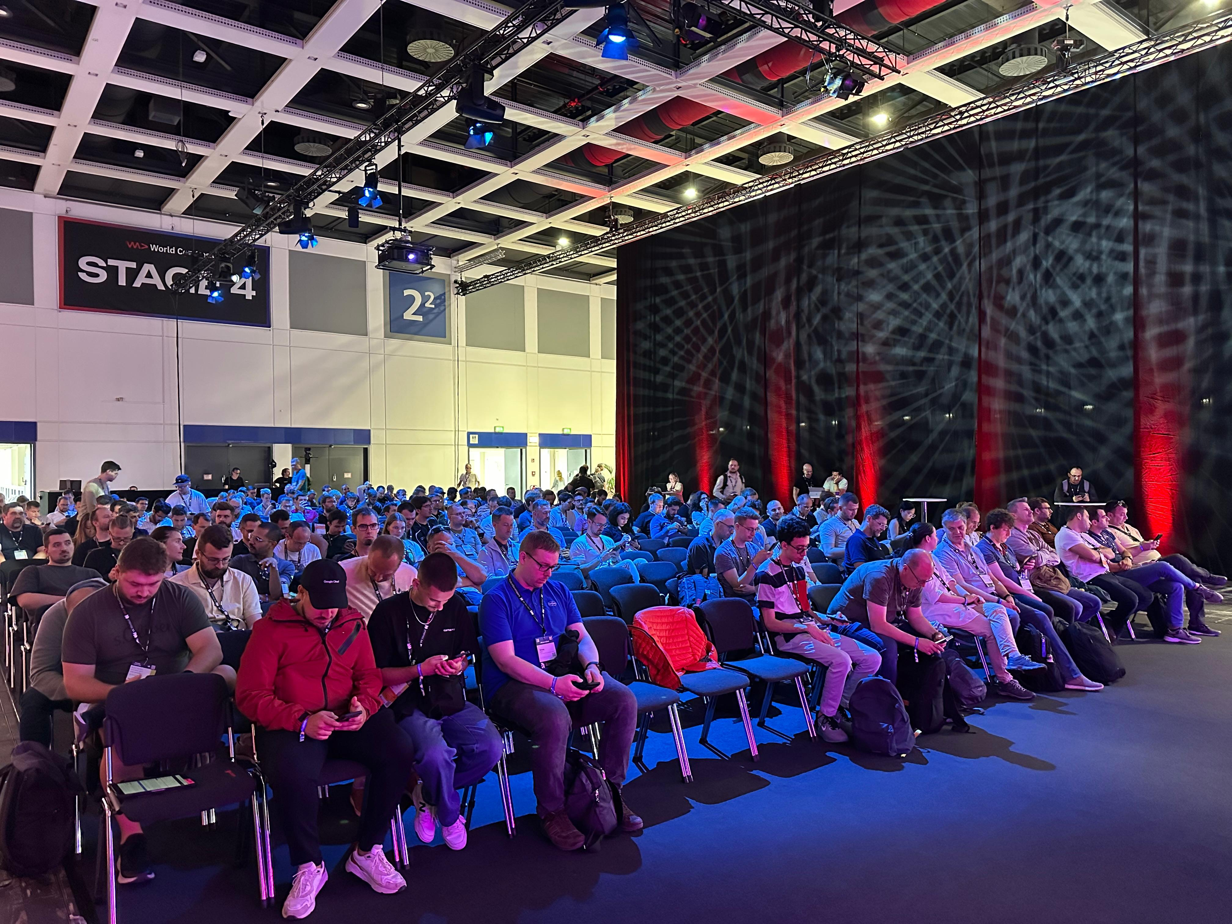

WeAreDevelopers World Congress 2025
Notes:
15.000 visitors
500 speakers
11 Stages .
Each session 30 mins
3 different buildings in a large expo center
Mostly topics are AI
Developers from Mercedes, GitHub, Microsoft, Docker, Windsurf talked…

Slide 14
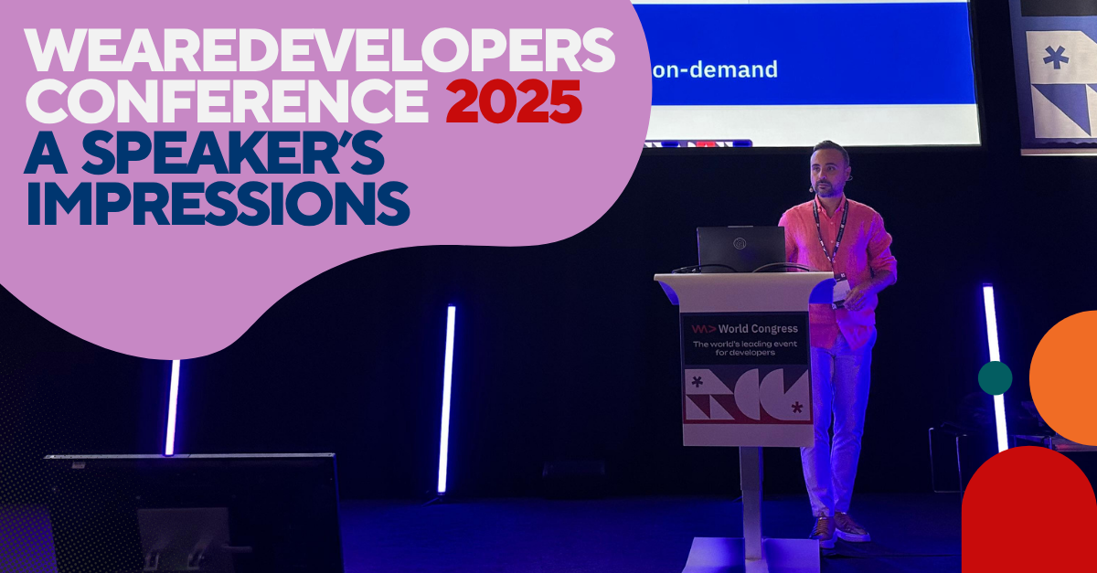
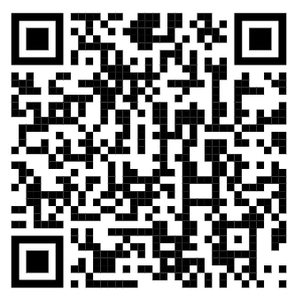
https://volosoft.com/blog/wearedevelopers-2025-a-speakers-impressions

Slide 15

Until 31st July 2025
✅ New license + Renewal license + Extra developer seats

Slide 16
That's all from me 😊

